Slide 1

Group Assignment
TBA5150 - Geohazards and risks

Slide 2

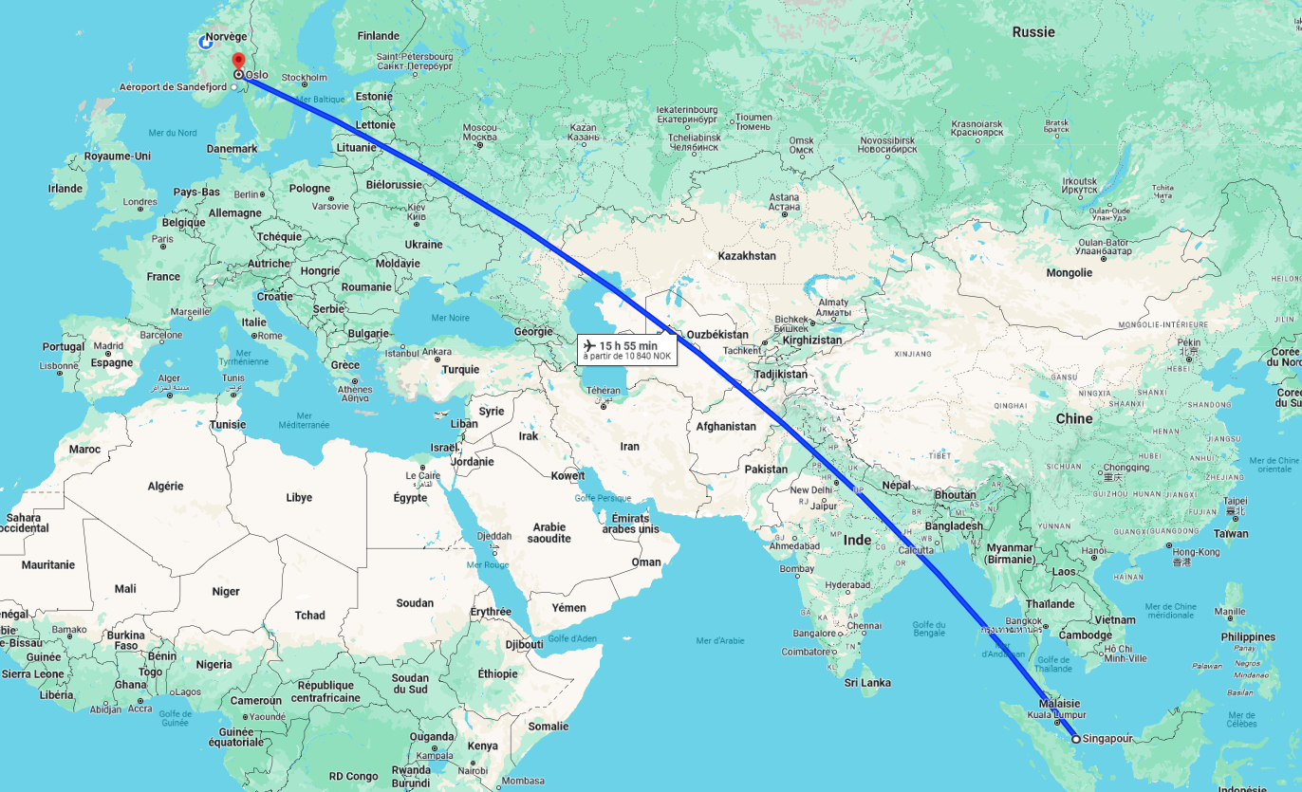

Introduction

Slide 3

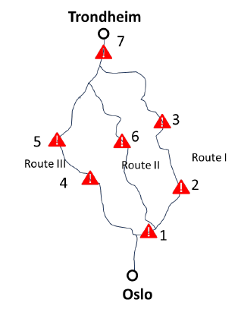

Introduction

Slide 4
Contents
Problem definition
Factor of safety
Data analysis
FOSM
FORM
Monte Carlo
Classic approach
Importance sampling
Comparison of methods
System reliability
Complex system approach
Problem resolution
Conclusion

Slide 5
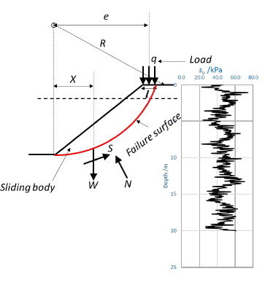
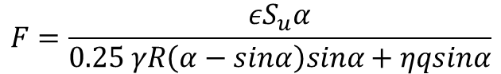
Problem definition
Factor of safety
$$F=\frac{εS_{u}α}{0.25 γR\left(α−sinα\right)sinα+ηqsinα}$$
ϵ: model error
Su: undrained shear strength
R: radius of the slip surface
γ : unit weight of soil
q: vertical loading
α : center angle of the slope
η : geometric coefficient
L: length of slip
W: weight of the soil mass

Slide 6
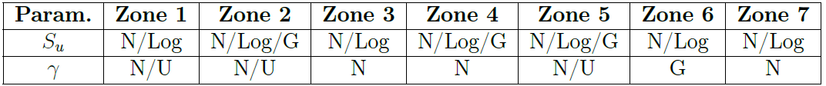
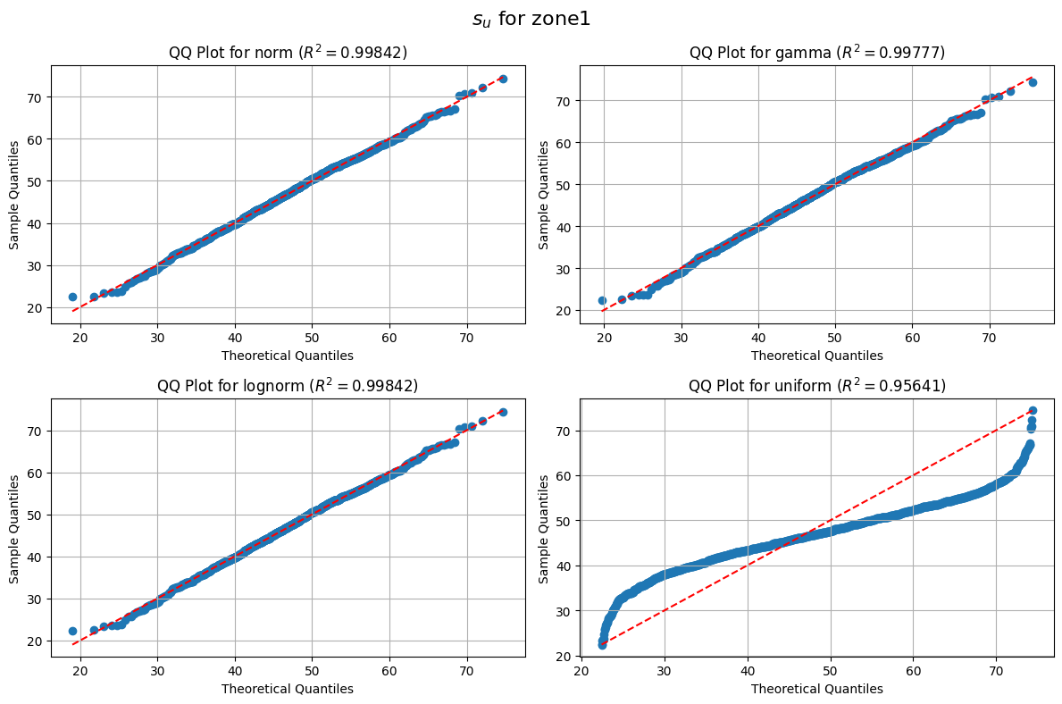
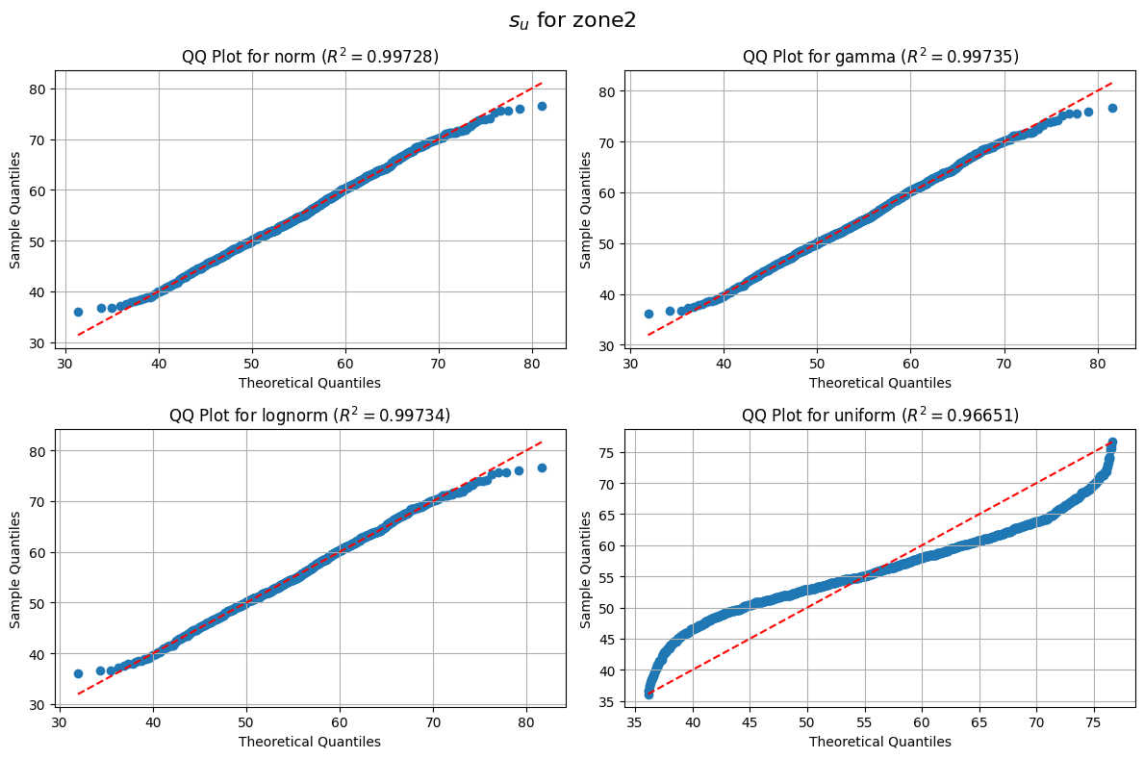
Problem definition
Data analysis

Slide 7
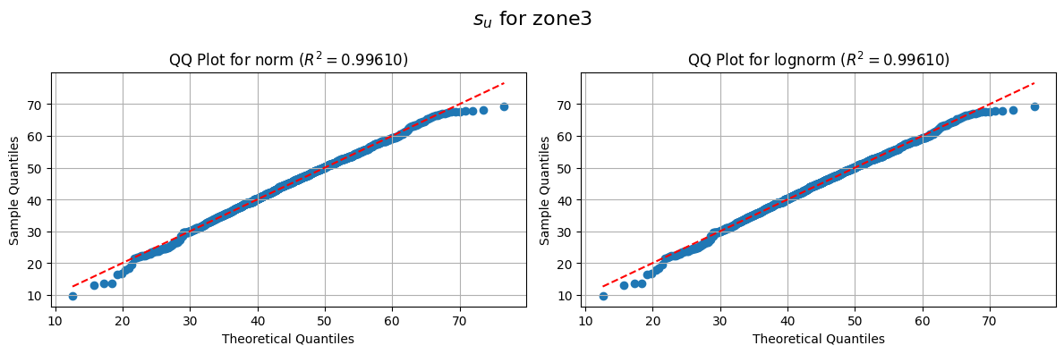
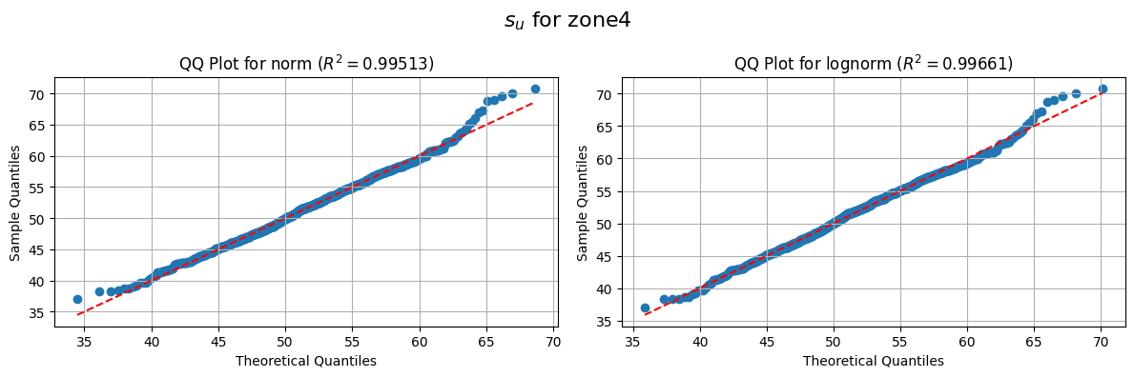
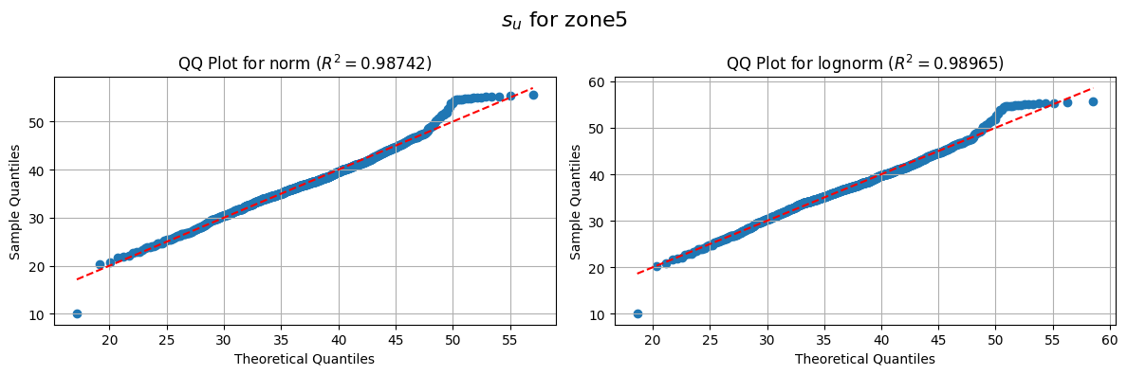
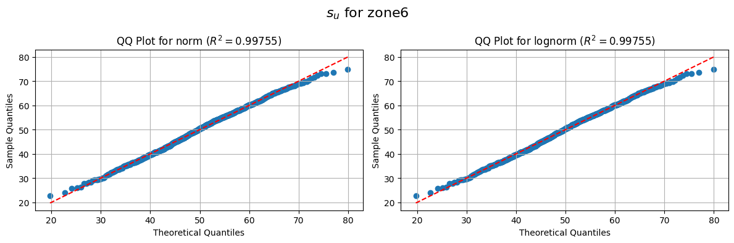
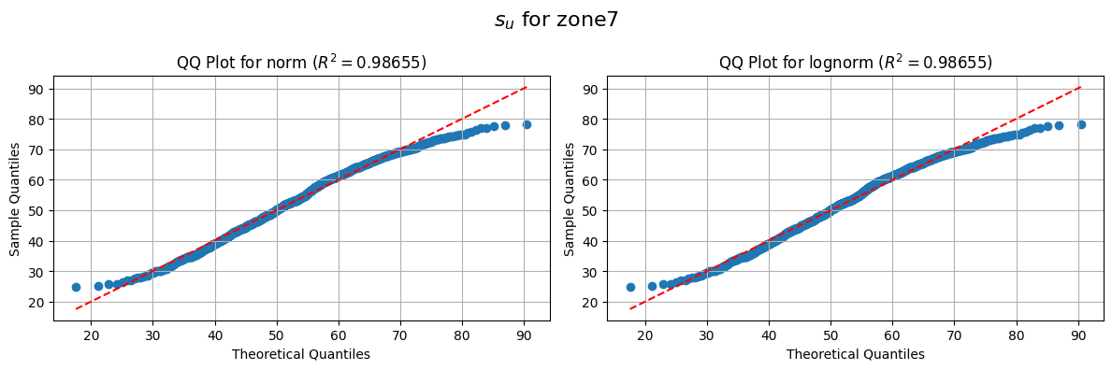
Problem definition
Data analysis

Slide 8
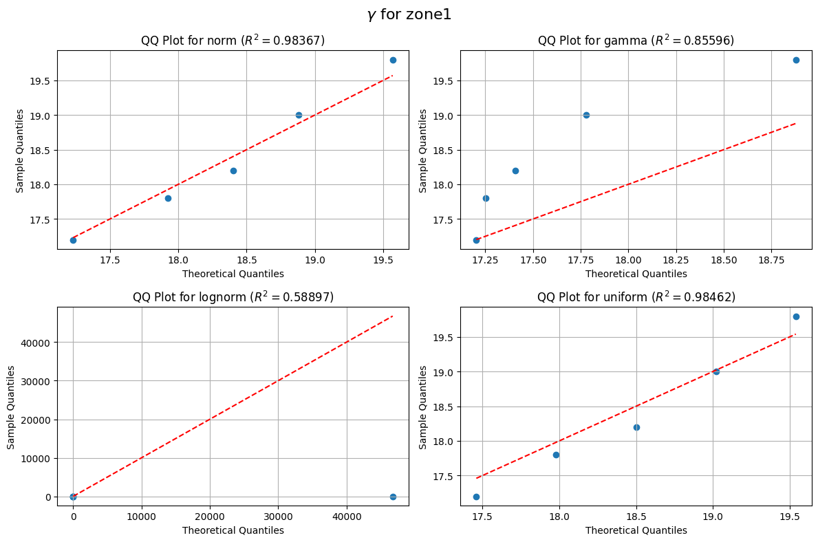
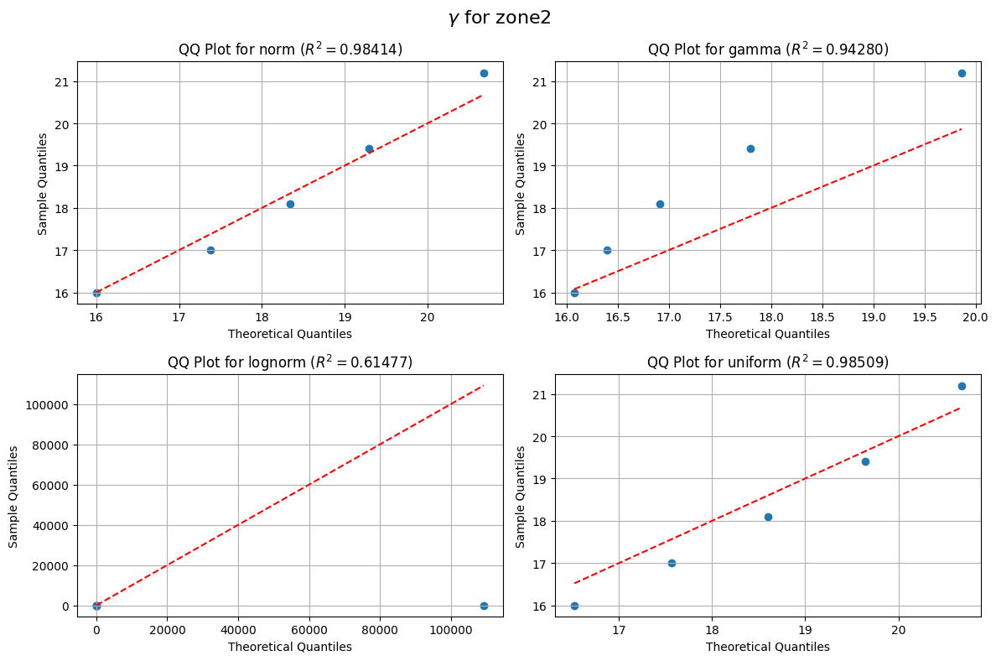
Problem definition
Data analysis

Slide 9
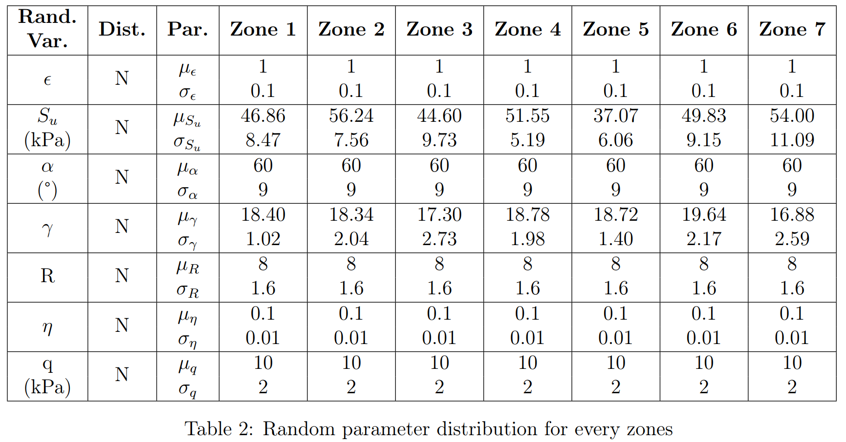
Problem definition
Conclusion

Slide 10
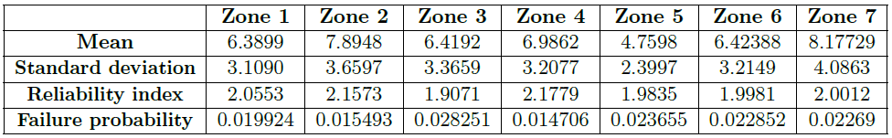
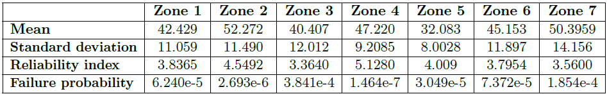
FOSM
g = F - 1
g = R - S
Different performance function returns different probability of failure. Because FOSM does a linear approximation of the performance function at the mean of performance function only and calculates the reliability index. So, if the linear approximation of the performance function at the mean is not a good approximation, FOSM can over or underestimate the reliability index.

Slide 11
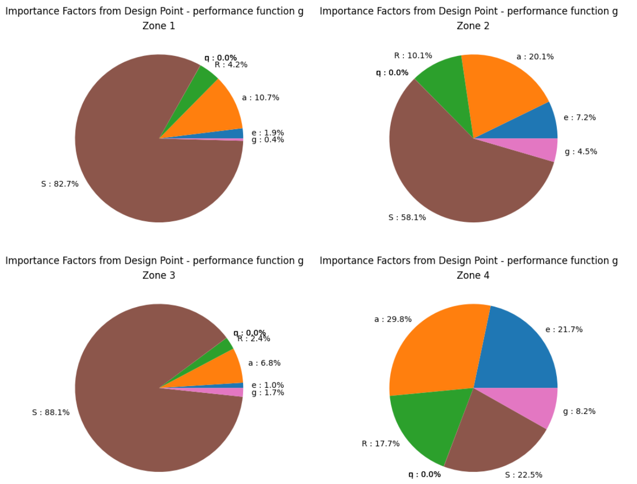
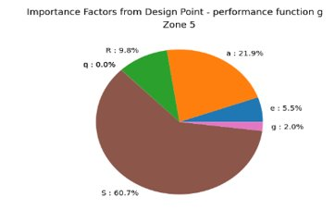
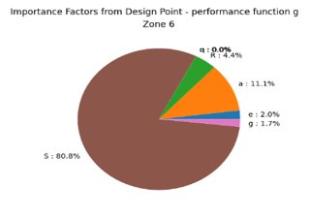
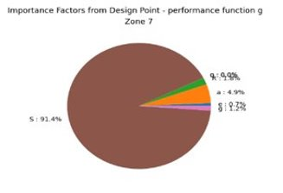
FORM
Importance Factors

Slide 12
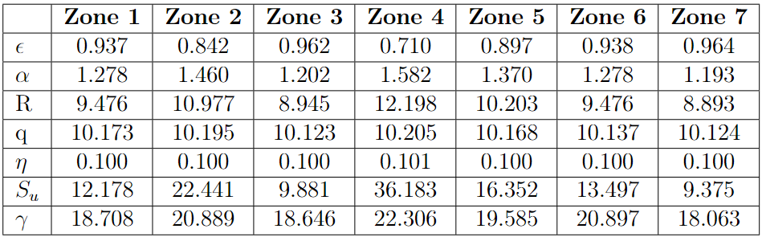
FORM
Results
Design point in standard event domain

Slide 13
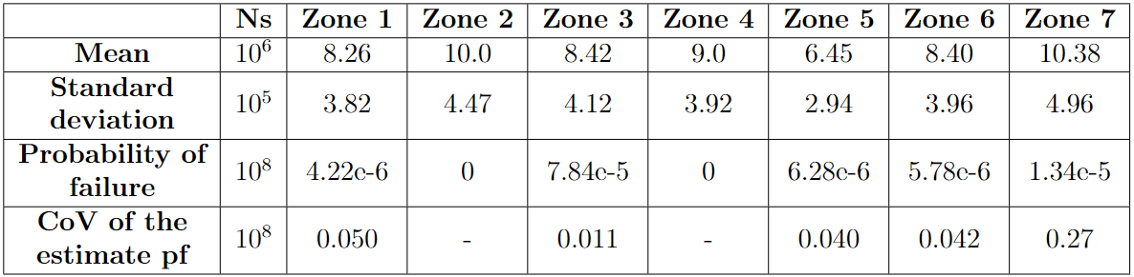
Monte Carlo

Slide 14
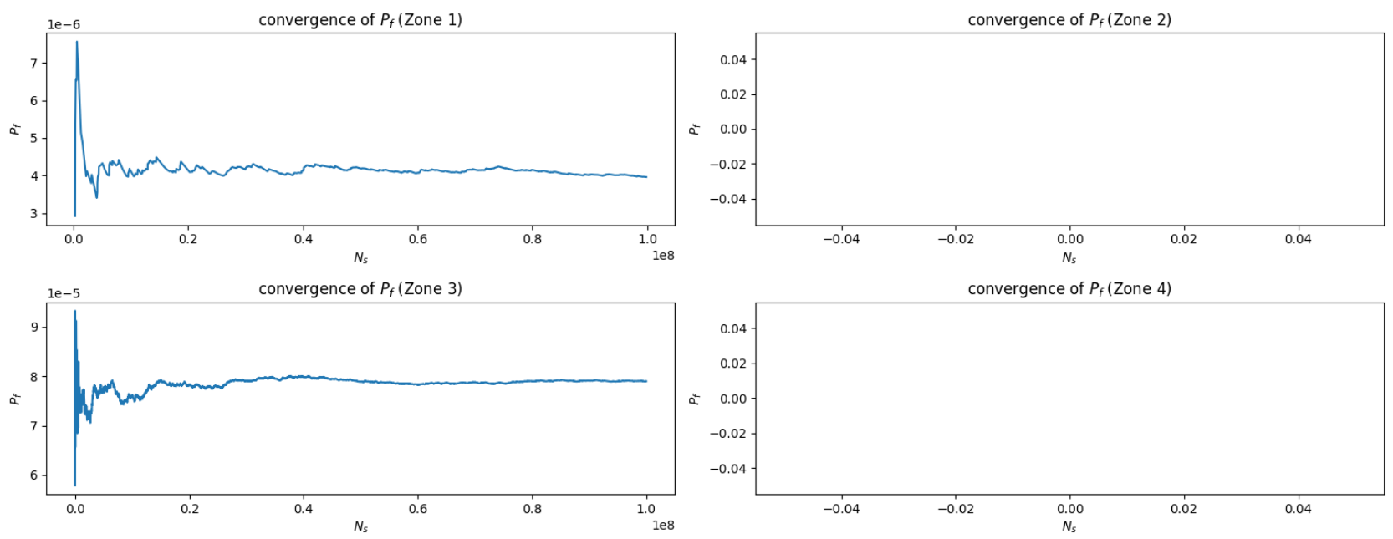
Monte Carlo

Slide 15
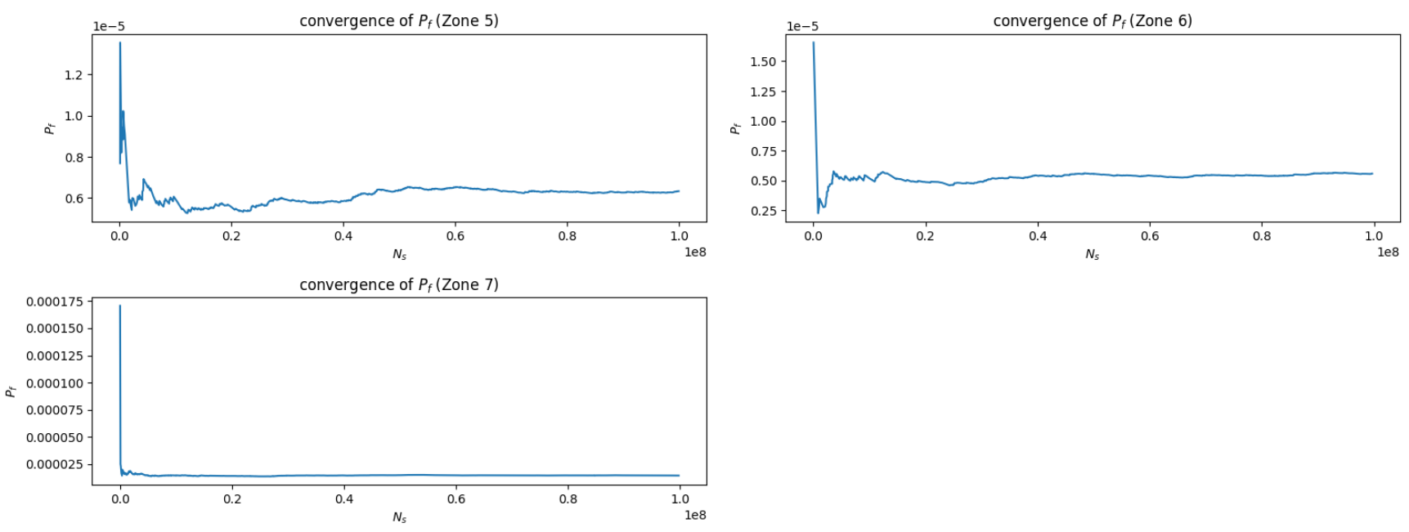
Monte Carlo

Slide 16
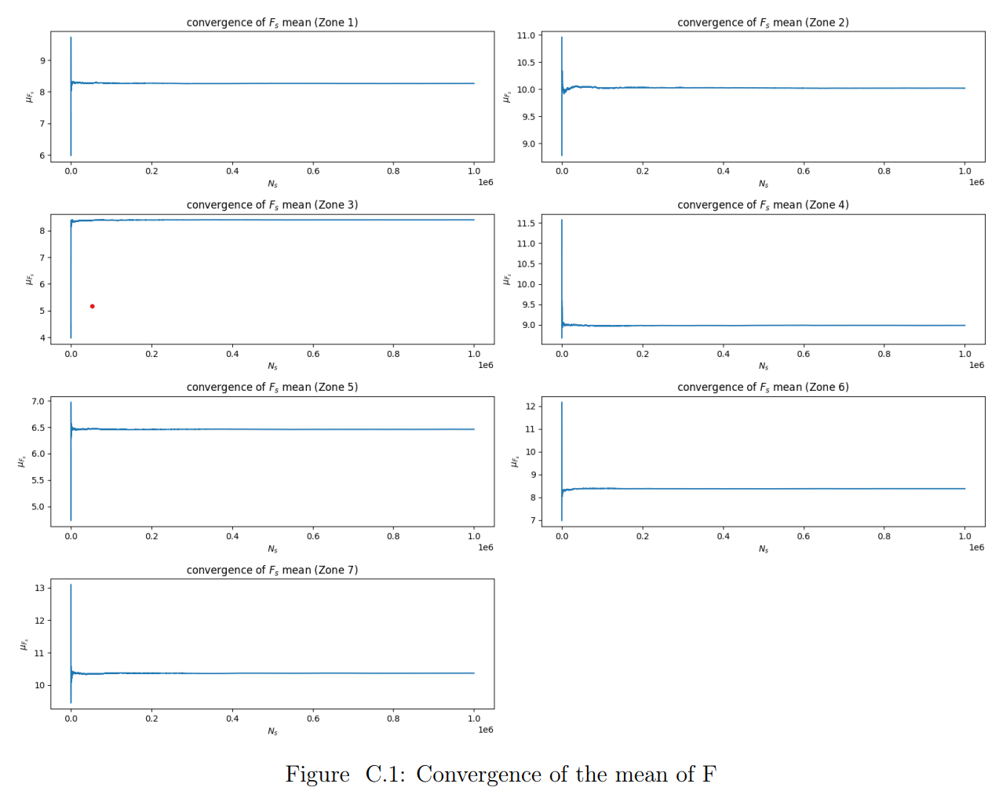
Monte Carlo

Slide 17
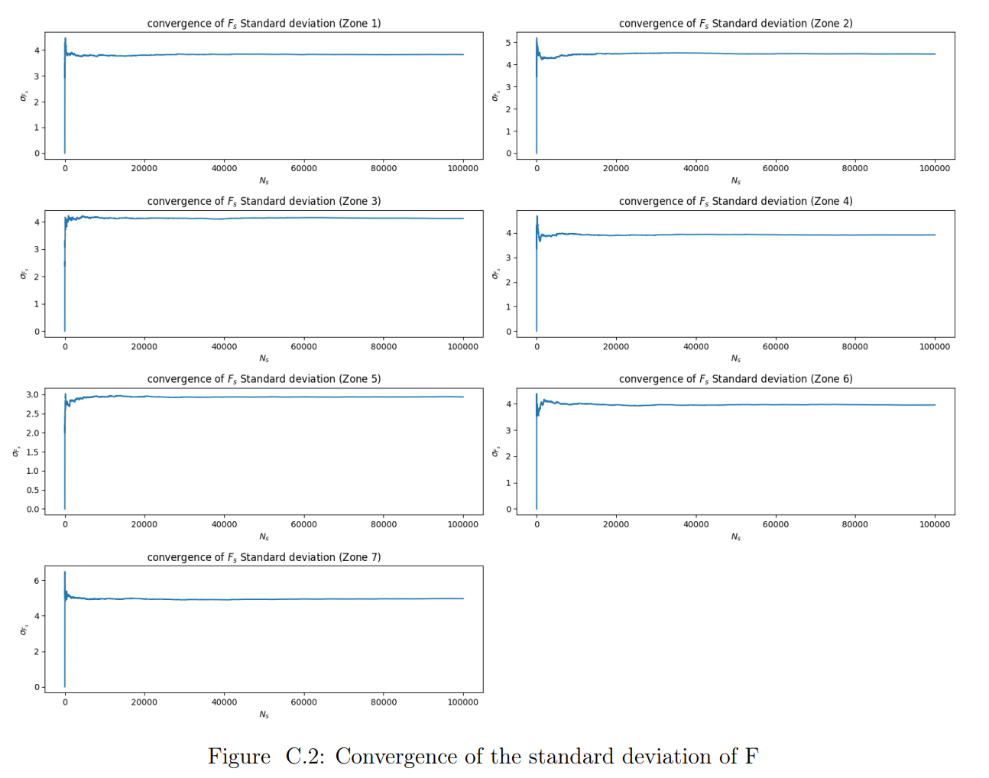
Monte Carlo

Slide 18
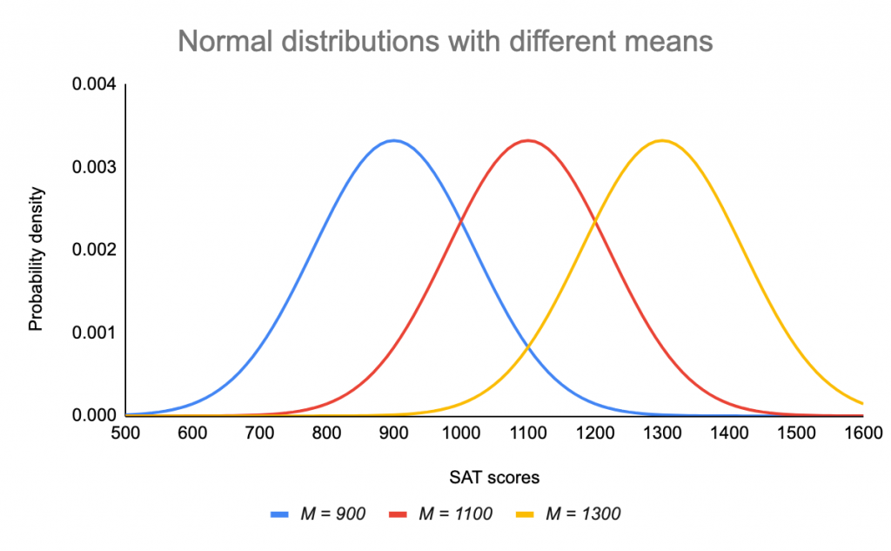
Monte Carlo

Slide 19
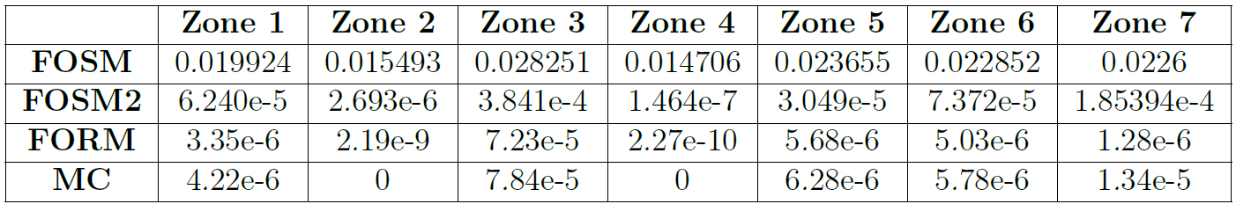
Comparison

Slide 20
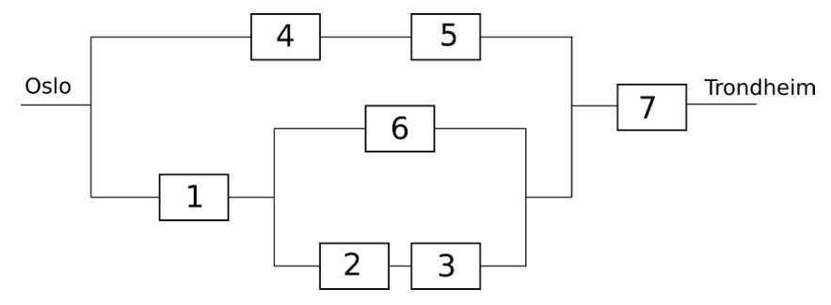
System reliability

Slide 21
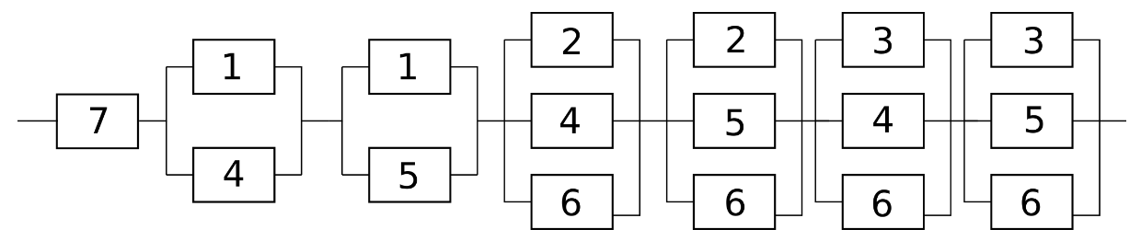
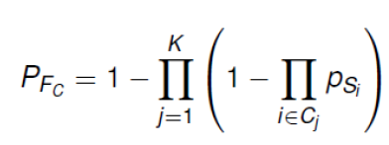
System reliability
Minimal cuts
Pf =

Slide 22
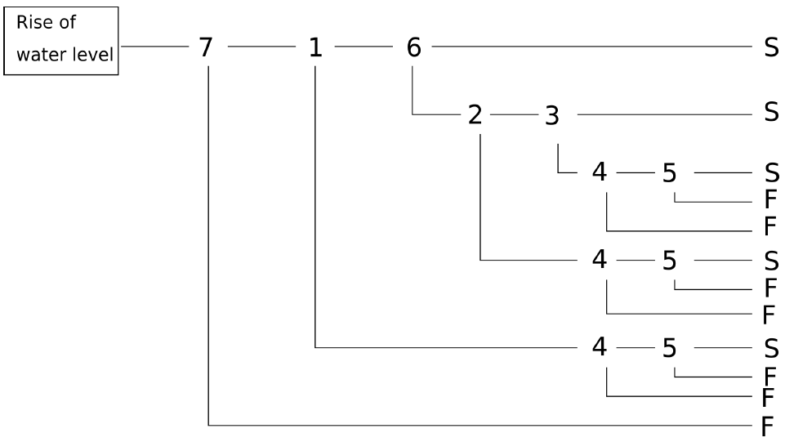
System reliability
Tree event

Slide 23
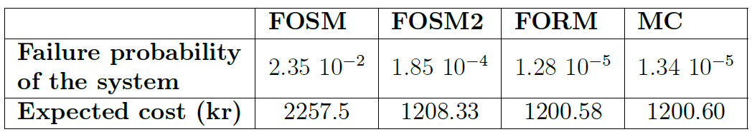
System reliability

Slide 24
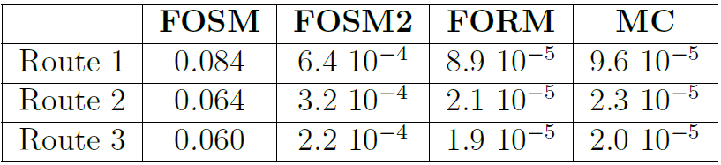

Expected cost
Failure
8.9*10⁻⁵
46200 Kr
Route 1
Success
1 - 8.9*10⁻⁵
1200 Kr
Failure
2.1*10⁻⁵
46200 Kr
Route 2
Success
1 - 2.1*10⁻⁵
1200 Kr
Failure
1.9*10⁻⁵
46200 Kr
Route 3
Success
1 - 1.9*10⁻⁵
1200 Kr
Flight
1
26200 Kr

Slide 25
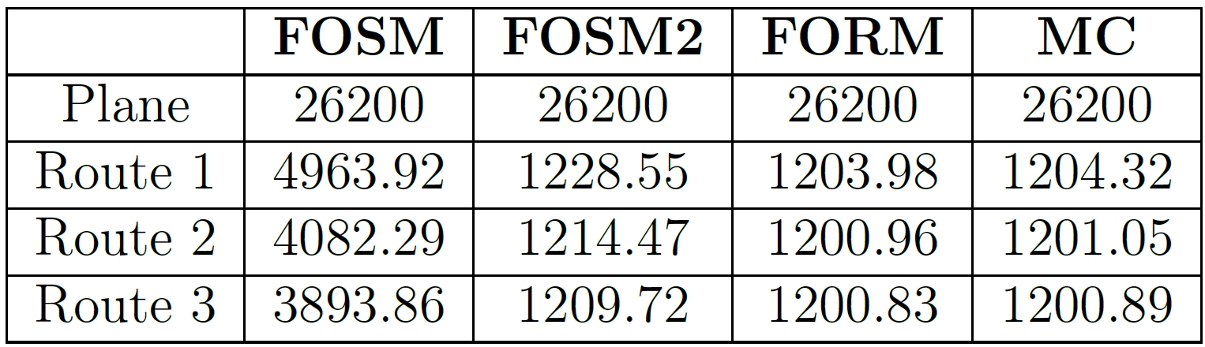
Expected cost
Failure probabilities of the routes

Slide 26



Conclusion

Slide 27
So, what's your choice now ?

